Slide 1
EDA – Beer Sales

Slide 2

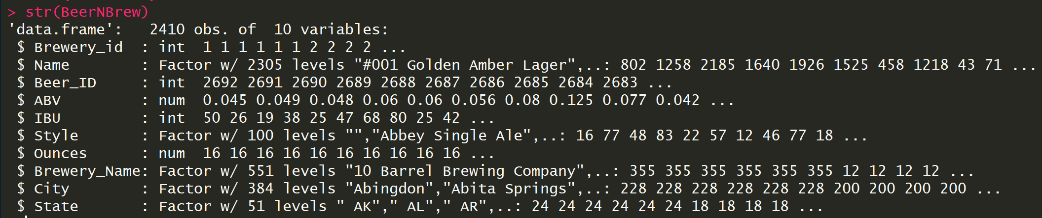
The basics

Slide 3
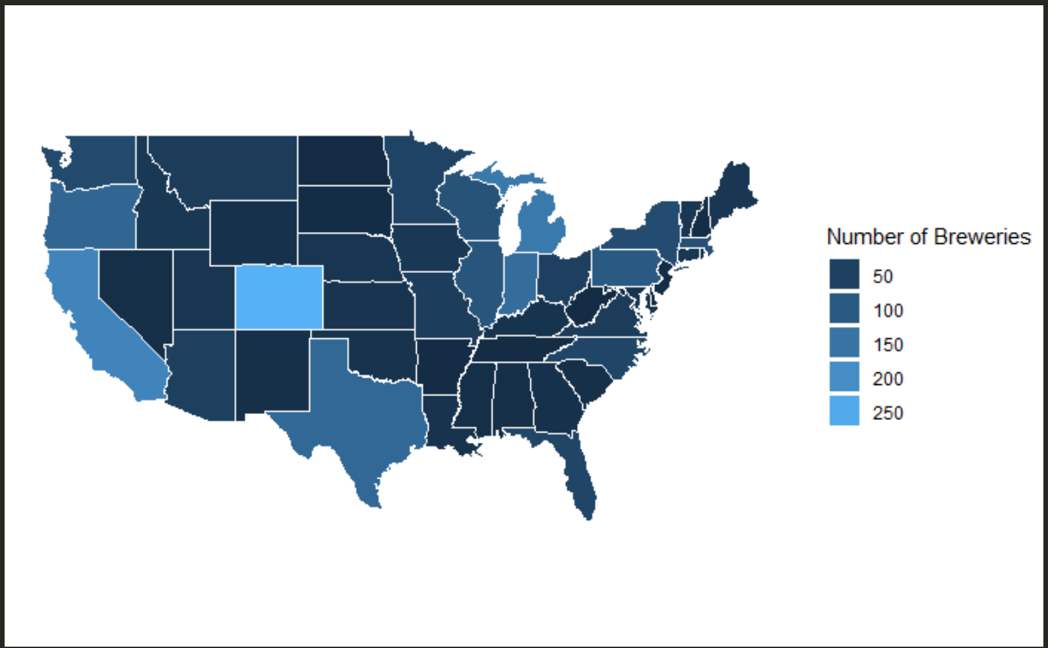
Breweries per state
Colorado clearly wins
Map could be improved by including breweries per capita

Slide 4
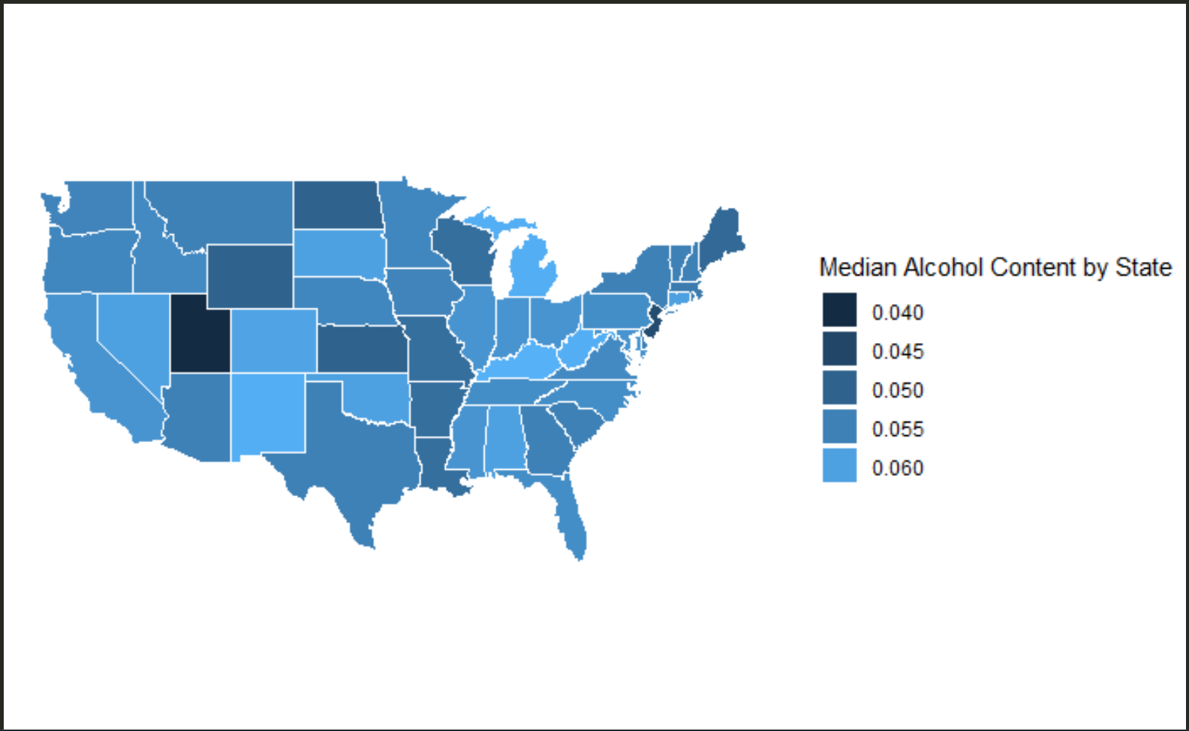
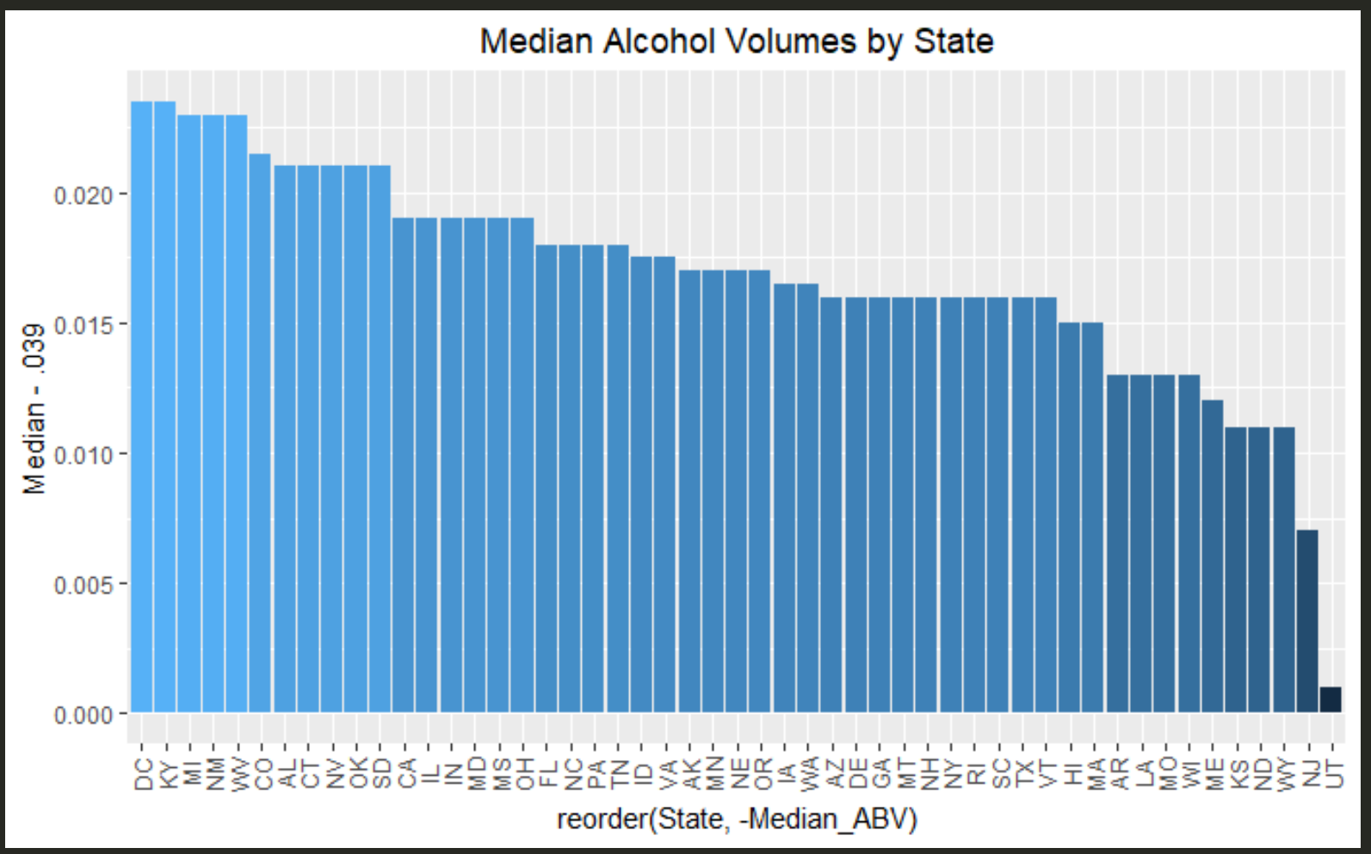
Alcohol Content
Highest alcohol content
Washington, DC
Kentucky
Michigan
Lowest alcohol content
Wyoming
New Jersey
Utah

Slide 5
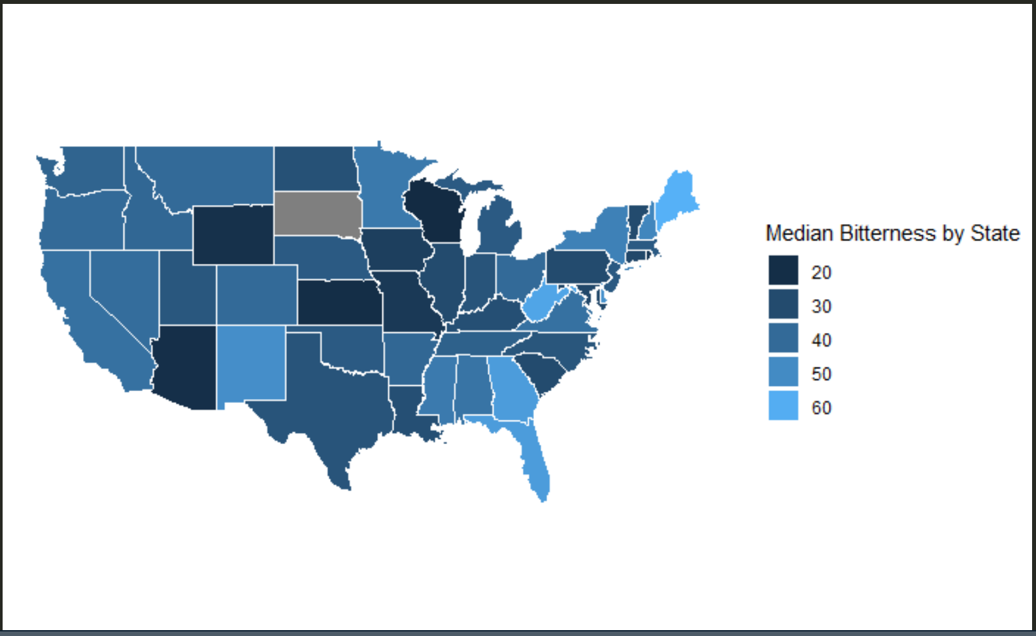
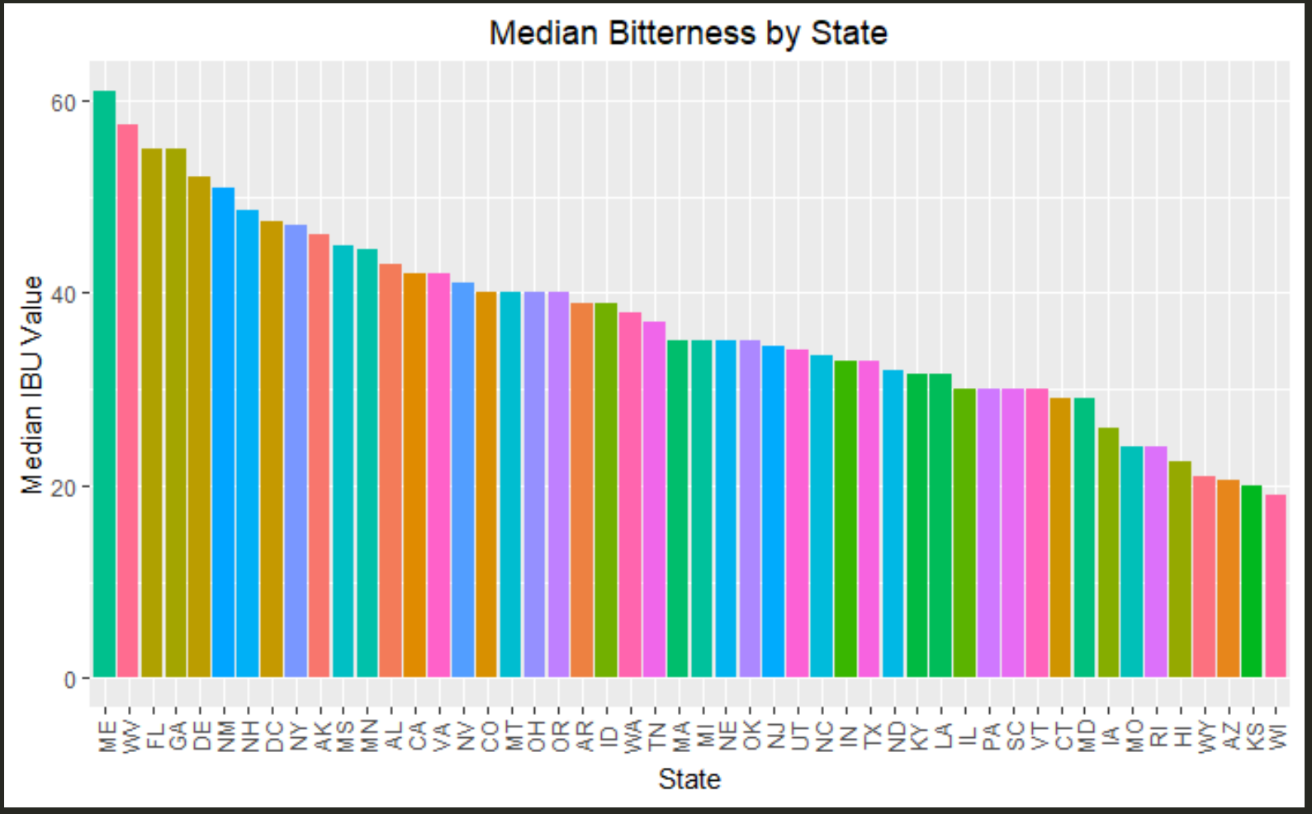
Bitterness
Most Bitter
Maine
West Virginia
Florida
Least Bitter
Wisconsin
Kansas
Arizona

Slide 6
Next steps
North Dakota
Why isn’t it showing up on the bitterness bar chart & Map?
Fine tune maps
log transformations?
Titles, color schemes
If time permits
Bitterness and Alcohol content by city
Linear models
Alcohol content
Bitterness
Is there an interaction between bitterness and alcohol content?
Bigger questions we can’t answer yet
What is the ideal bitterness and alcohol content in each state / city ?
Classification?

